Slide 1
Rising Waters
A Machine Learning Approach to Flood Prediction

Slide 2
TEAM DETAILS
Sekha Satya Krishna(team leader)
246K1A05D3
CSE
Sanjana Jyothula
246K1A05A4
CSE
Roop teja Bandam
256K5A0312
Mech
Rajani Anoop Chandra
246K1A0341
Mech
Yenugu Thrishanth satya rama raju
246K1A05E0
CSE

Slide 3
Project Overview
• Predict flood risk using ML
• Uses weather and rainfall data
• Supports disaster preparedness

Slide 4
Technologies
• Python
• Pandas
• NumPy
• Scikit-learn
• Flask
• Joblib
• PyCharm

Slide 5
Workflow
Environment Setup
Dataset
Preprocessing
Model Training
Model Comparison
Best Model
Flask App

Slide 6
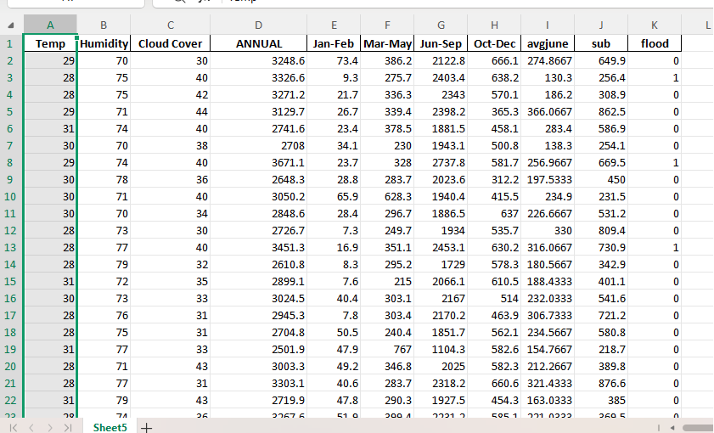
Dataset
Features:
Temp, Humidity, Cloud Cover, ANNUAL,
Jan-Feb, Mar-May, Jun-Sep, Oct-Dec,
avgjune, sub
Target: flood

Slide 7
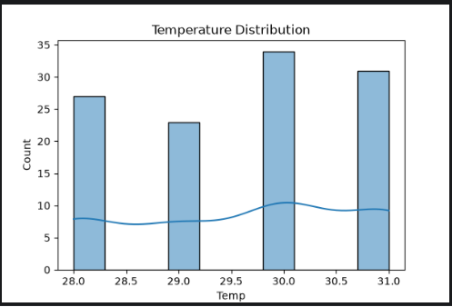
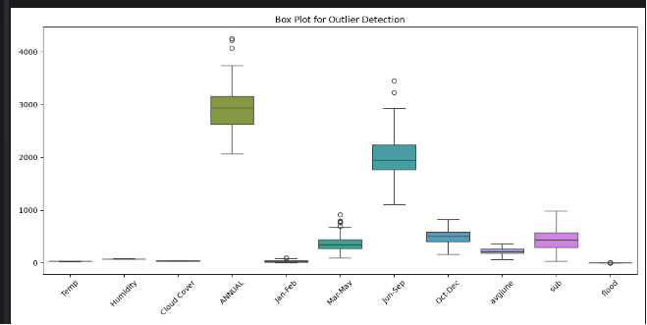
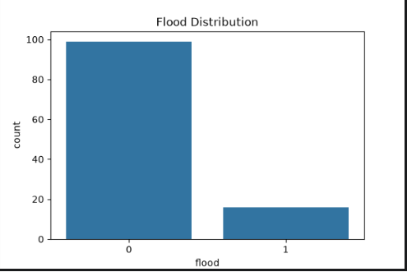
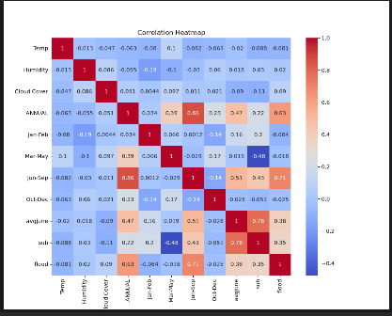
Models
• Logistic Regression
• Decision Tree
• Random Forest
• KNN

Slide 8
Model Comparison
Compared all models using accuracy.
Saved best model as best_model.pkl.

Slide 9
Flask App
Loads best_model.pkl
Accepts user input
Predicts Flood / No Flood

Slide 10
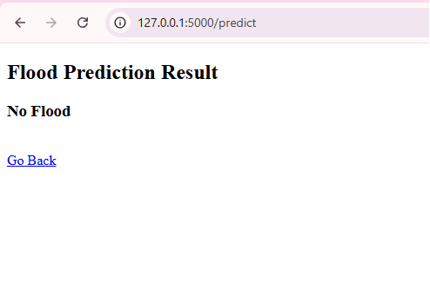
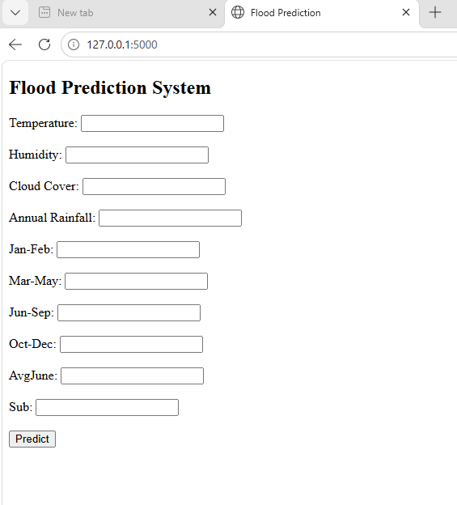
Results
• Working prediction system
• Web interface tested
• Ready for demo

Slide 11
Thank You

